Slide 1
Implementation of Cognitive Interviewing Standards at NCHS
Kristen Miller, Ph.D
Collaborating Center for Question Design and Evaluation Research
National Center for Health Statistics

Slide 2
Notes:
The practices follow the timeline of a cognitive interviewing project--- go through the steps; the cycle and building on past projects

Slide 3
Q-Suite: NCHS Applications for Cognitive Interviewing Studies
Q-Video: Database of tagged cognitive interviews
Q-Notes: Data entry and analysis tool
Q-Bank: Online library of cognitive interview reports
Notes:
Talk about how an application suite that we developed in house that facilitates the

Slide 4
Integration of applications into the work flow:
Workflow structure of applications are aligned with OMB guidelines
Systematizes analytic processes and provides transparency
Improve the scientific rigor and credibility of cognitive interviewing studies
Institutionalizes best practices
Added Bonus
Makes interview data and study findings more accessible to survey research community -- Increases the enduring value of individual studies
Notes:
So not only do these application improve credibility, they also allow for more efficient use of cog studies

Slide 5
Q-Bank https://www.cdc.gov/Qbank
Library of Evaluation Studies:
Search database for evaluated survey questions & corresponding evaluation documents
Enhance understanding on the type of information questions are capturing
Resource for Question Evaluation
Learn about various evaluation methods
Review lessons learned from agencies and research organizations
Contact Us: QBank@cdc.gov

Slide 6
Q-Bank Data
140+ Evaluation Reports
4600+ Evaluated Survey Questions
300+ Question Topics
50+ Surveys
20+ Contributing Agencies & Research Organizations

Slide 7
Search
Search questions by:
Question Topic Survey Agency Keywords

Slide 8
Question Details

Slide 10
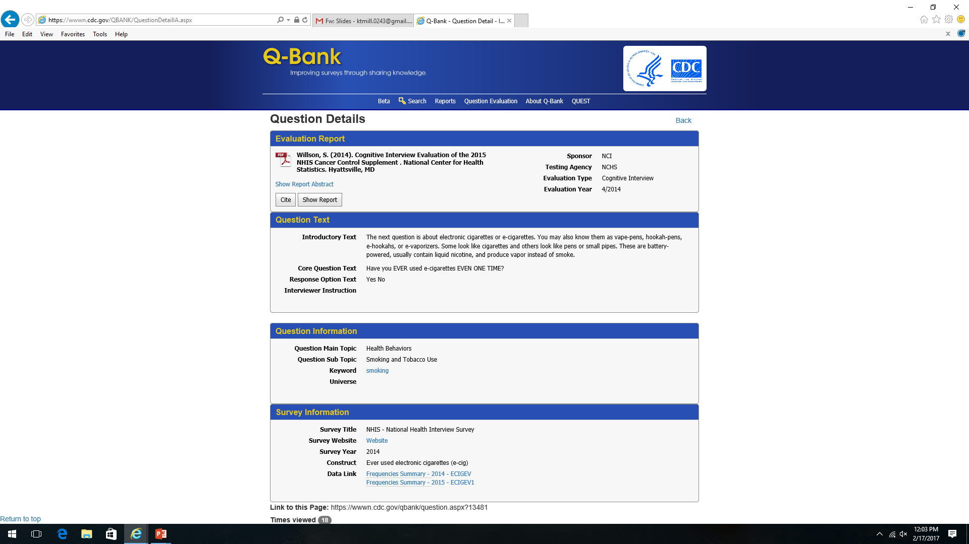

Slide 12
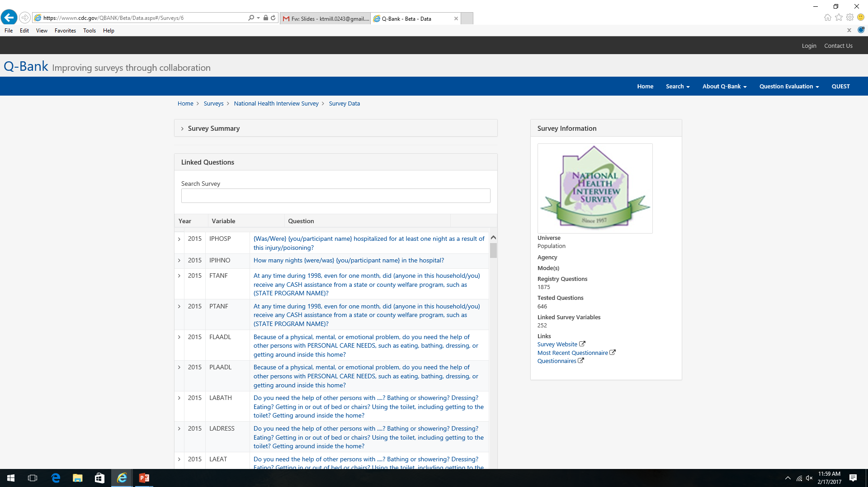

Slide 14
Q-Notes: Data Entry and Analysis Tool
On-line data entry and analysis tool
Standardized documentation process & audit trail of data
Allows for quick but thorough, multi-level analysis
Continuous oversight for project leaders
Facilitates communication among interviewing team
Developed out of practical need
For complex studies
Large samples
Multiple countries
Different languages
New interviewers
Designed around qualitative analysis principles
Coding themes
Making within and across interview comparisons
Two Versions
On-line: No PII
In-House QNotes: Links video
Notes:
Transparent Analysis: Analysis must be transparent such that an outsider can understand and assess the findings
Each step must be documented
Findings can be traced back to raw data
Allows readers to examine and judge the quality of the data and results

Slide 15
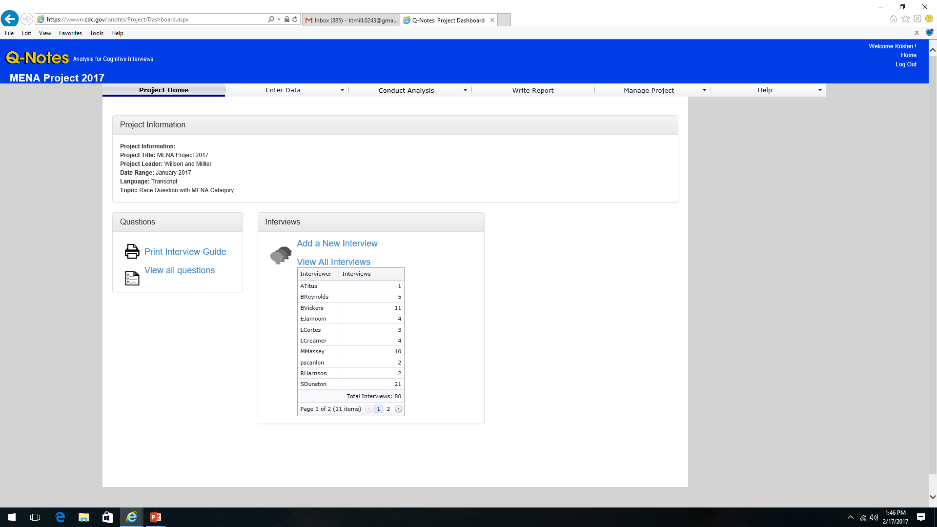
Notes:
Describe features on the page

Slide 16
Enter Summary Notes

Slide 17
Enter Summary Notes
Indicate respondent’s answer choice here
Enter summary interview notes here. This is part of the analytic process. Notes should be comprehensive but succinct.

Slide 18
Enter Summary Notes (Other Languages)
Summary notes in Spanish go here.
Translation into English goes here- these are the notes that will be used for analysis.

Slide 19
Code Themes
Code by question
Coding scheme appears below each respondent narrative. Click on theme to select

Slide 21
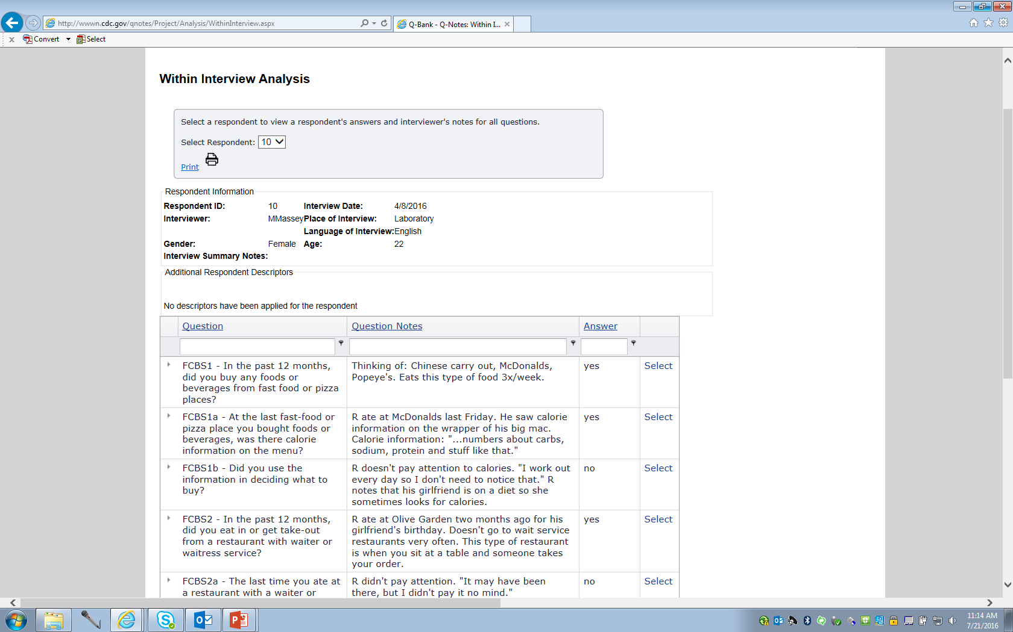
Conduct analysis
Within Interview Analysis:
How did this particular respondent interpret Q? Did this person experience difficulty answering?
Select respondent…
…to view all notes from a single respondent

Slide 22
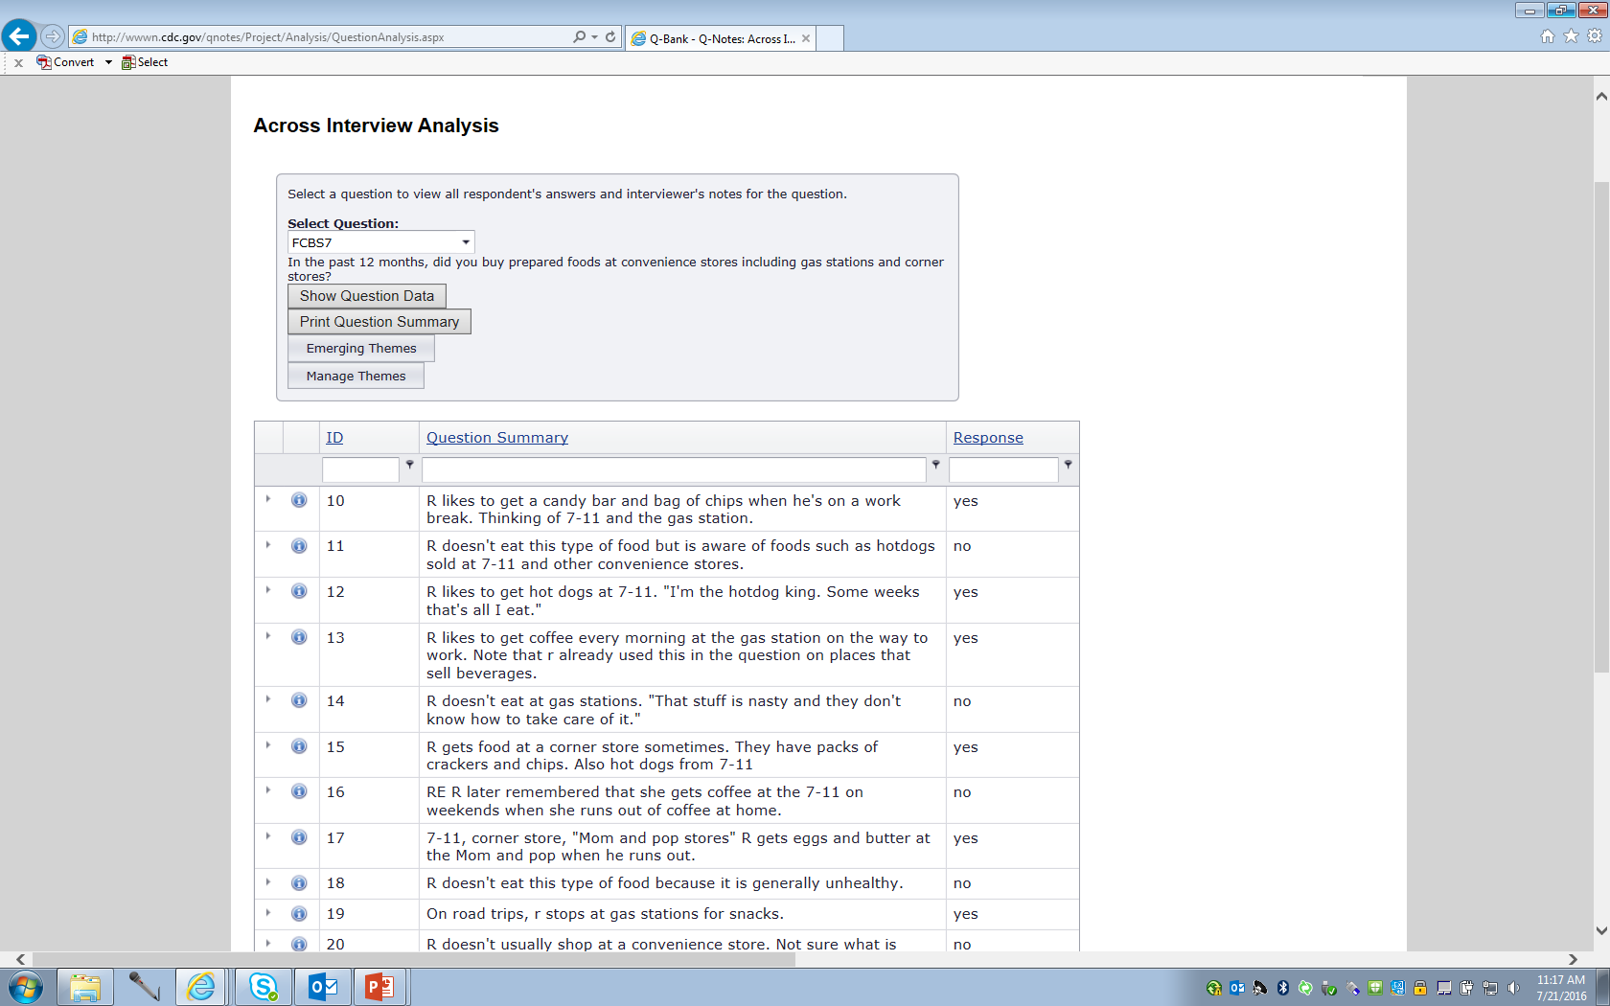
Conduct analysis
Across Interview Analysis:
What are the various ways in which Q was interpreted?
Select a question…
…to see all notes for a single question

Slide 23
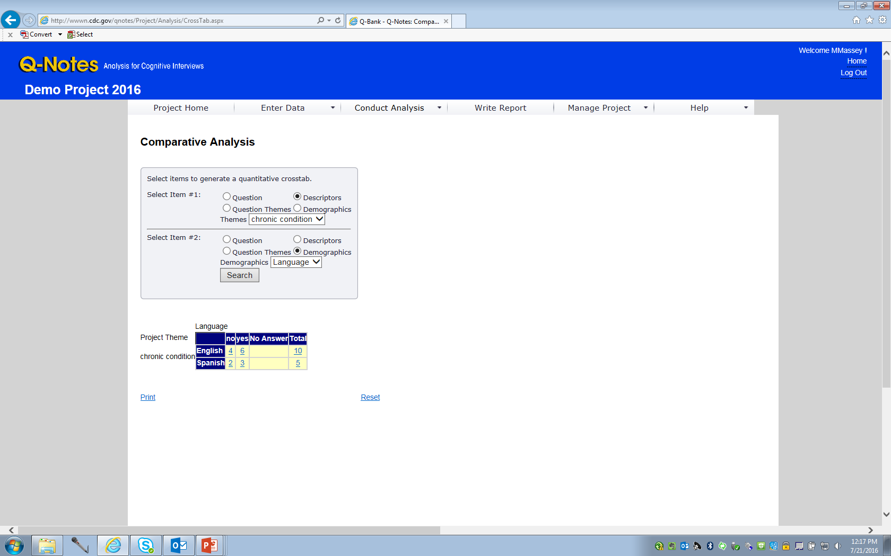
Conduct analysis
Across Group Analysis:
Did different groups interpret Q differently?
Compare anything…
…to anything else.

Slide 25
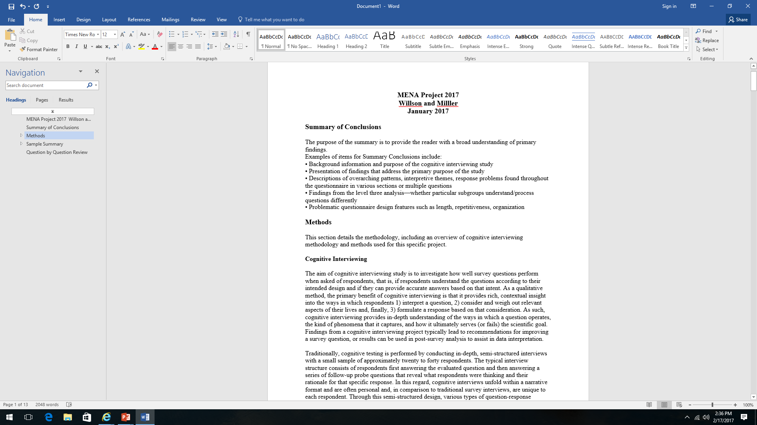

Slide 26
Notes:
The practices follow the timeline of a cognitive interviewing project--- go through the steps; the cycle and building on past projects

